Slide 1



Slide 2
What you'll learn
Mapping Constraints
DBMS Keys
DBMS Generalization
DBMS Specialization
DBMS Aggregation
Convert ER into Table
Notes:
Introduction Slide

Slide 3

Notes:
Introduction Slide

Slide 4

What is ACID properties of Transactions?
Atomicity, Consistency, Isolation, Database
Atomicity, Consistency, Isolation, Durability
Atomicity, Consistency, Inconsistent, Durability
Automatically, Concurrency, Isolation, Durability
Notes:
b

Slide 5
A transaction completes its execution is said to be
Saved
Loaded
Rolled
Committed
Notes:
Introduction Slide

Slide 6
In the architecture of a database system external level is the __________
Physical level
Logical level
Conceptual level
View level
Notes:
Introduction Slide

Slide 7
In Relational modes Cardinality is termed as
Number of tuples
Number of Attributes
Number of tables
Number of Columns
Notes:
Introduction Slide

Slide 8
The view of total database content
Physical view
External view
Conceptual view
Internal View
Notes:
C

Slide 9
What you'll learn
Mapping Constraints
DBMS Keys
DBMS Generalization
DBMS Specialization
DBMS Aggregation
Convert ER into Table
Notes:
Introduction Slide

Slide 10
Mapping Constraints
A mapping constraint is a data constraint that expresses the number of entities to which another entity can be related via a relationship set.
It is most useful in describing the relationship sets that involve more than two entity sets.
For binary relationship set R on an entity set A and B, there are four possible mapping cardinalities.
One to one (1:1)
One to many (1:M)
Many to one (M:1)
Many to many (M:M)
Notes:
Introduction Slide

Slide 11
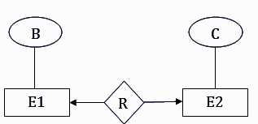
One-to-one
In one-to-one mapping, an entity in E1 is associated with at most one entity in E2, and an entity in E2 is associated with at most one entity in E1.
Notes:
Introduction Slide

Slide 12
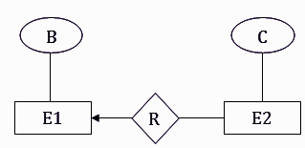
One-to-many
In one-to-many mapping, an entity in E1 is associated with any number of entities in E2, and an entity in E2 is associated with at most one entity in E1.
Notes:
Introduction Slide

Slide 13
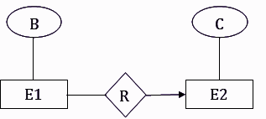
Many-to-one
In one-to-many mapping, an entity in E1 is associated with at most one entity in E2, and an entity in E2 is associated with any number of entities in E1.
Notes:
Introduction Slide

Slide 14
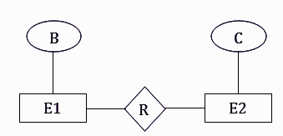
Many-to-many
In many-to-many mapping, an entity in E1 is associated with any number of entities in E2, and an entity in E2 is associated with any number of entities in E1.
Notes:
Introduction Slide

Slide 15
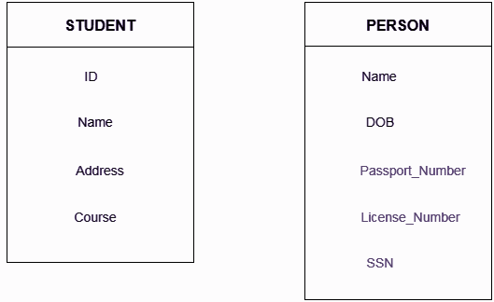
DBMS Keys
Keys play an important role in the relational database.
It is used to uniquely identify any record or row of data from the table. It is also used to establish and identify relationships between tables.
Notes:
Introduction Slide

Slide 16
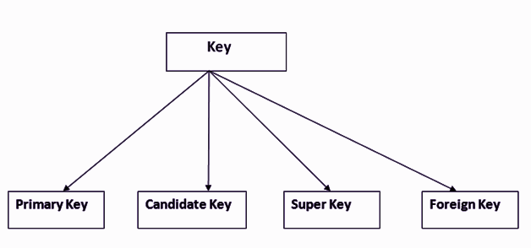
Types of key
Notes:
Introduction Slide

Slide 17
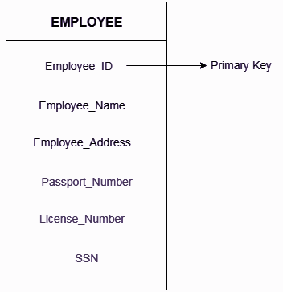
Primary key
It is the first key which is used to identify one and only one instance of an entity uniquely.
Notes:
Introduction Slide

Slide 18
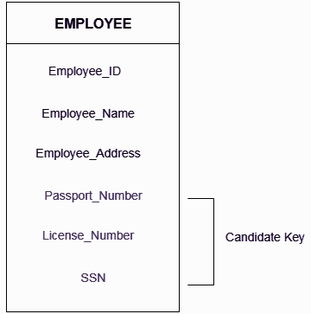
Candidate key
A candidate key is an attribute or set of an attribute which can uniquely identify a tuple.
Notes:
Introduction Slide

Slide 19
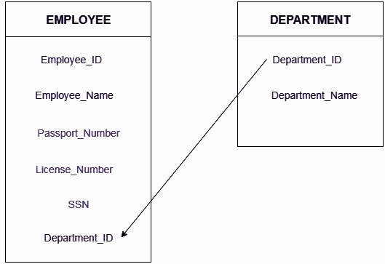
Foreign key
Foreign keys are the column of the table which is used to point to the primary key of another table.
Notes:
Introduction Slide

Slide 20
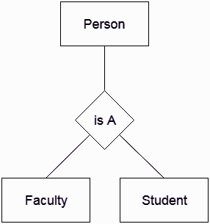
DBMS Generalization
Generalization is like a bottom-up approach in which two or more entities of lower level combine to form a higher level entity if they have some attributes in common.
In generalization, an entity of a higher level can also combine with the entities of the lower level to form a further higher level entity.
Notes:
Introduction Slide

Slide 21
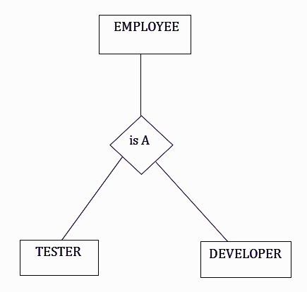
DBMS Specialization
Specialization is a top-down approach, and it is opposite to Generalization. In specialization, one higher level entity can be broken down into two lower level entities.
Notes:
Introduction Slide

Slide 22
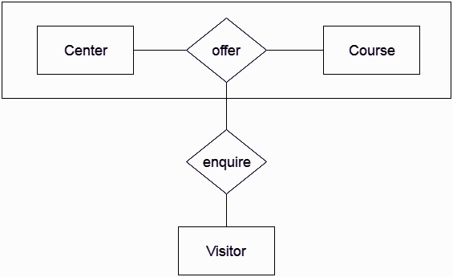
DBMS Aggregation
In aggregation, the relation between two entities is treated as a single entity. In aggregation, relationship with its corresponding entities is aggregated into a higher level entity.
Notes:
Introduction Slide

Slide 23
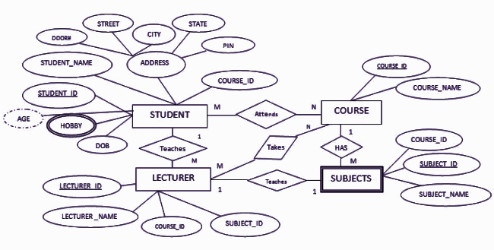
Convert ER into Table
Notes:
Introduction Slide

Slide 24
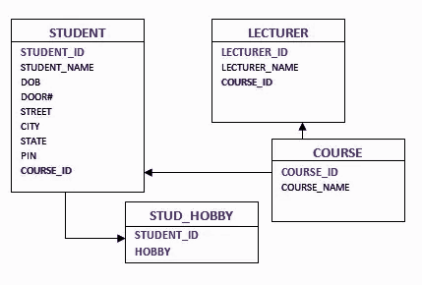
Solution
Notes:
Introduction Slide

Slide 25
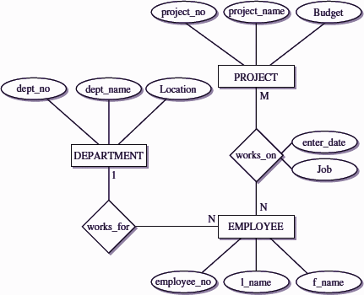
Problem
Notes:
Introduction Slide

Slide 26
Notes:
Introduction Slide

Slide 27
It is used to establish an association between related tables.
Line
Relationship
Primary Key
Records
Notes:
Introduction Slide

Slide 28
This key that uniquely identifies each record is called :
Primary Key
Key Record
Unique Key
Field Name
Notes:
Introduction Slide

Slide 29
Two tables can be linked with relationship to _____
Ensure data entry
Ensure data integrity
Create Primary Key
Ensure Foreign Key
Notes:
Introduction Slide

Slide 30
Key
Which one of the following is a set of one or more attributes taken collectively to uniquely identify a record?
Candidate key
Sub key
Super key
Foreign key
Notes:
Introduction Slide

Slide 31
Student(ID, name, dept name, tot_cred)
In this query which attributes form the primary key?
Name
Dept
Tot_cred
ID
Notes:
Introduction Slide

Slide 32


Slide 33







/ethnuscodemithra
Ethnus Codemithra
/ethnus
/code_mithra
THANK YOU
https://learn.codemithra.com/
Leave your Feedback
https://bit.ly/3hNlZGQ
codemithra@ethnus.com
+91 7815 095 095
+91 9019 921 340

